Slide 1
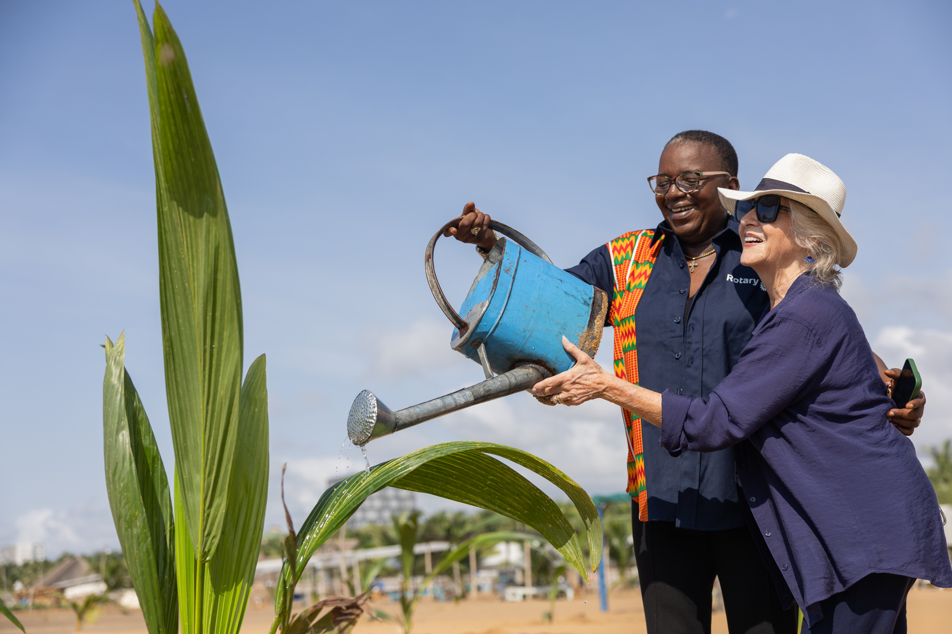

Every Rotarian, Every Year
Doing Good in the World with The Rotary Foundation

Slide 2
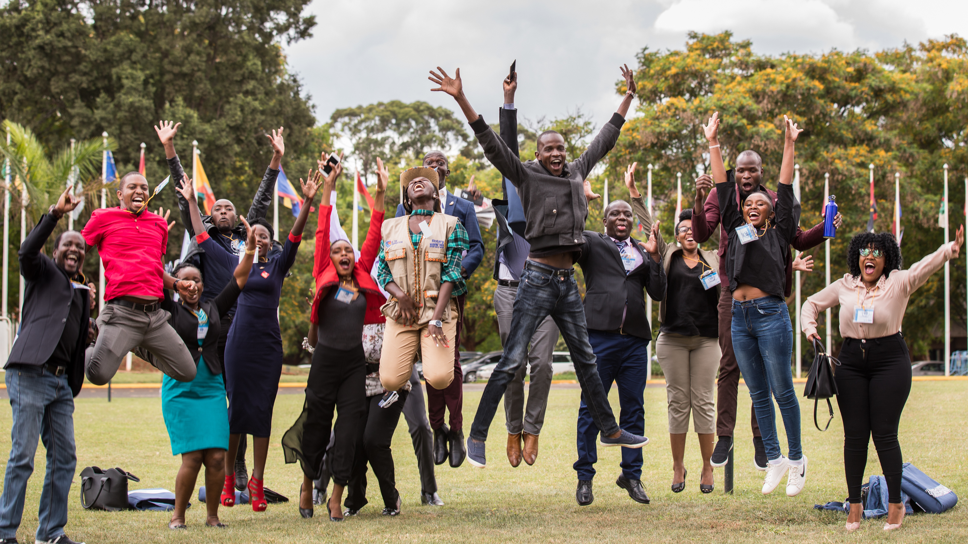

The Rotary Foundation helps Rotary and Rotaract club members
advance world understanding, goodwill, and peace by
improving health, providing quality education, protecting the environment, and alleviating poverty.
Notes:
The Rotary Foundation’s mission is to advance world understanding, goodwill, and peace by improving health, providing quality education, protecting the environment, and alleviating poverty.
We hope members recognize themselves in these objectives, especially because the Foundation was created to help them do good in the world.

Slide 3

88% of Foundation funds are spent on program awards and operations.
We’ve earned 17 consecutive four-star ratings from Charity Navigator.
TRUSTWORTHY AND EFFECTIVE
We’re an organization you can support with confidence.
The Rotary Foundation continues to far exceed the standards set by independent rating services like Charity Navigator.
Notes:
Our Foundation is carefully overseen by your fellow members, the Trustees of The Rotary Foundation. They ensure that your donations are invested well and spent wisely to make a difference around the world.
Our members’ generosity and Rotary’s work haven’t gone unrecognized. For the 17th consecutive year, The Rotary Foundation has received the highest rating — four stars — from Charity Navigator, an independent evaluator of charities in the U.S., for demonstrating strong financial health and a commitment to accountability and transparency.
The rating reflects Charity Navigator's assessment of how the Foundation uses donations, sustains its programs and services, and practices good governance and openness.

Slide 4
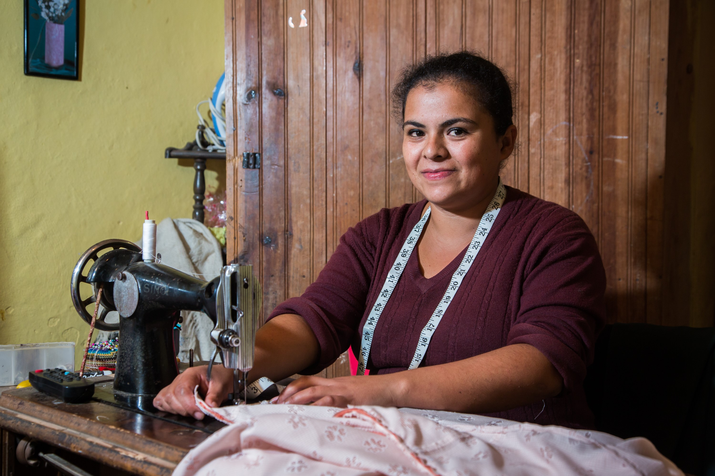


THE ANNUAL FUND
Notes:
Our Foundation’s Annual Fund helps pay for local and international grant projects. Contributions to the Annual Fund make our humanitarian impact possible.
When you give to the Annual Fund, you help people like Chih-Fan Weng, a farmer in Taiwan. Farmers in the area have long grown cabbage using pesticides and turning the soil over each year. These conventional farming practices were endangering the water supply for Yilan County’s 450,000 residents. Rotary members from District 3490, in partnership with National Ilan University and local businesses, helped the community adopt more sustainable farming practices and grow the higher-value crops of chestnuts and truffles. Rotary members also supported training in e-commerce and marketing to help the farmers sell their harvest. Since 2021, 18 landowners in Datong Township have increased their revenues 15-fold through the project, which has resulted in agricultural diversification, better educational opportunities, more free time, and a cleaner and healthier environment. The project is supported by Rotary Foundation global grant #2010776. Yilan, Taiwan. 19 December 2022.
Giving to the Annual Fund supports member-led projects like these — initiatives created at the local level and developed to meet community needs, while fostering international friendship. Through a single gift, you can help people like Chih-Fan Weng improve life for their communities.

Slide 5


ANNUAL FUND — areas of focus
170
$59.4
189
$15.3
57
101
$8.9
Notes:
Our Foundation has specific areas of focus that relate to its mission. These areas of focus improve people’s lives, build international relationships, and promote a more peaceful world.
Which of these areas of focus resonates with you? What topics are you passionate about?
The Foundation can help you turn your interest in a cause into action and lasting change. Our members lead many kinds of efforts in these areas, often with the support of Rotary Foundation grants.

Slide 6
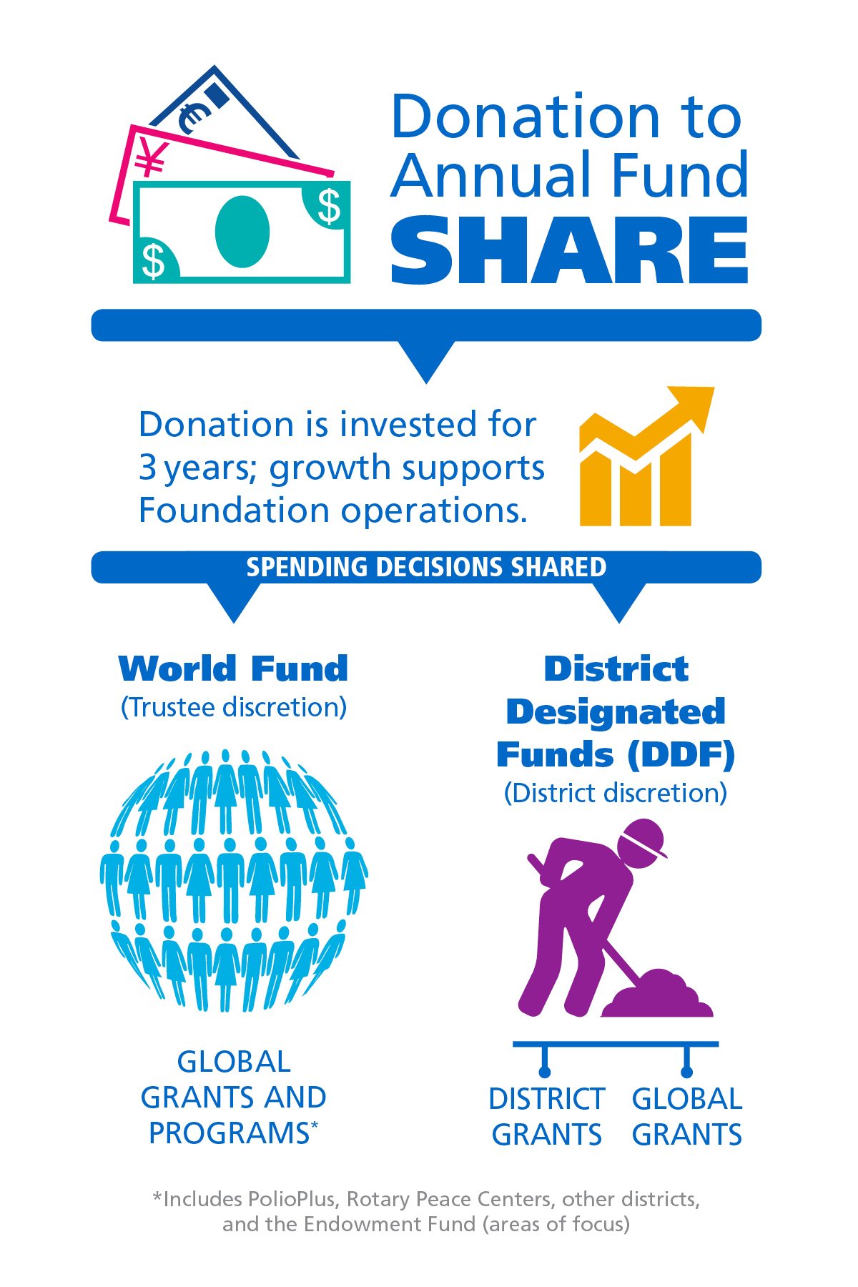

ANNUAL FUND-SHARE
When you give to the Annual Fund-SHARE, The Rotary Foundation transforms your gifts into service projects that change lives close to home and around the world.
Learn more at: my.rotary.org/annual-fund
Notes:
When donors are asked why they support the Annual Fund, many say it’s because they get something back when they give.
When you contribute to the Annual Fund-SHARE, part of your gift becomes available for your district and its clubs to use however they want on Foundation programs.
[Consider giving the following explanation, depending on the audience.]
When you donate to the Annual Fund-SHARE:
Your contribution is invested for three years.
After three years, that money is made available to fund projects.**
A portion goes to District Designated Funds (also known as DDF). Your district can use those funds to support local and international projects. The district decides how to use the money.
A portion goes to the World Fund. This money is used for grants, grant matches, Foundation programs that are available to all Rotary districts, or aid where the Trustees determine it is needed most.
Districts that use both district grants and global grants get the full impact of gifts made by their members.
How many of you have participated in a global grant?
The World Fund is the source of the Rotary funding for your global grants.
And how many of you have participated in a district grant?
Those grants, too, are possible because members in your district gave to the Annual Fund.
The funds we have access to this year come from contributions made three years ago. (For example, funds available in 2025-26 are from contributions made in 2022-23.) That’s why it’s so important for members to support the Foundation consistently.
For more information about the Annual Fund, go to my.rotary.org/annual-fund.
**Note to presenter: 47.5% goes to the World Fund, and 47.5% goes to DDF.

Slide 7
Global grants make a BIG impact
[
Examples
Karen Pollard’s Jamacia Grant
Mark Benard’s El Salvador Grant
Lisa Parrish’s India Grant
Gene Parker’s Reverse Grants

Slide 8
District grants meet local Needs
48 District Grants Across our District
Examples include:
Back Pack Projects
Rotary Reads
Collaborative Grants
Hunger and Food Insecurity
Community Development
The Good Night Grants

Slide 9

Every rotarian, every year
Did you know that donors who gave US$25 to US$99 contributed more than US$5.5 million to the Foundation in 2024-25? If every member gives every year, it makes more life-changing, sustainable projects possible.
Also in 2024-25:
Members gave US$146.4 million to the Annual Fund.
35.5% of members donated to the Annual Fund.
82% of Rotary clubs supported the Annual Fund.
The Foundation awarded 1,424 global grants.
Notes:
The projects we just discussed were possible because Rotary members supported the Foundation and participated in Foundation grants.
Rotary has a fundraising initiative called Every Rotarian, Every Year. The goal is to increase both Annual Fund support and member engagement with the Foundation. How many of you had previously heard of Every Rotarian, Every Year?
The idea is that the Foundation could accomplish even more if every member gives at least US$25 to the Annual Fund yearly.
Here are the relevant numbers for 2024-25:
Donors who gave US$25 to US$99 contributed more than US$5.5 million to the Foundation.
Members gave US$146.4 million to the Annual Fund.
35.5% of members supported the Annual Fund as individual donors.
82% of Rotary clubs worldwide supported the Annual Fund.
The Foundation awarded 1,424 global grants.
With a third of members worldwide donating to the Annual Fund and becoming eligible for Every Rotarian, Every Year recognition, we’ve achieved a lot and improved the lives of many people. Can you imagine how much more we could do through grant-funded projects if more members contribute at least US$25 to the Annual Fund every year?

Slide 10
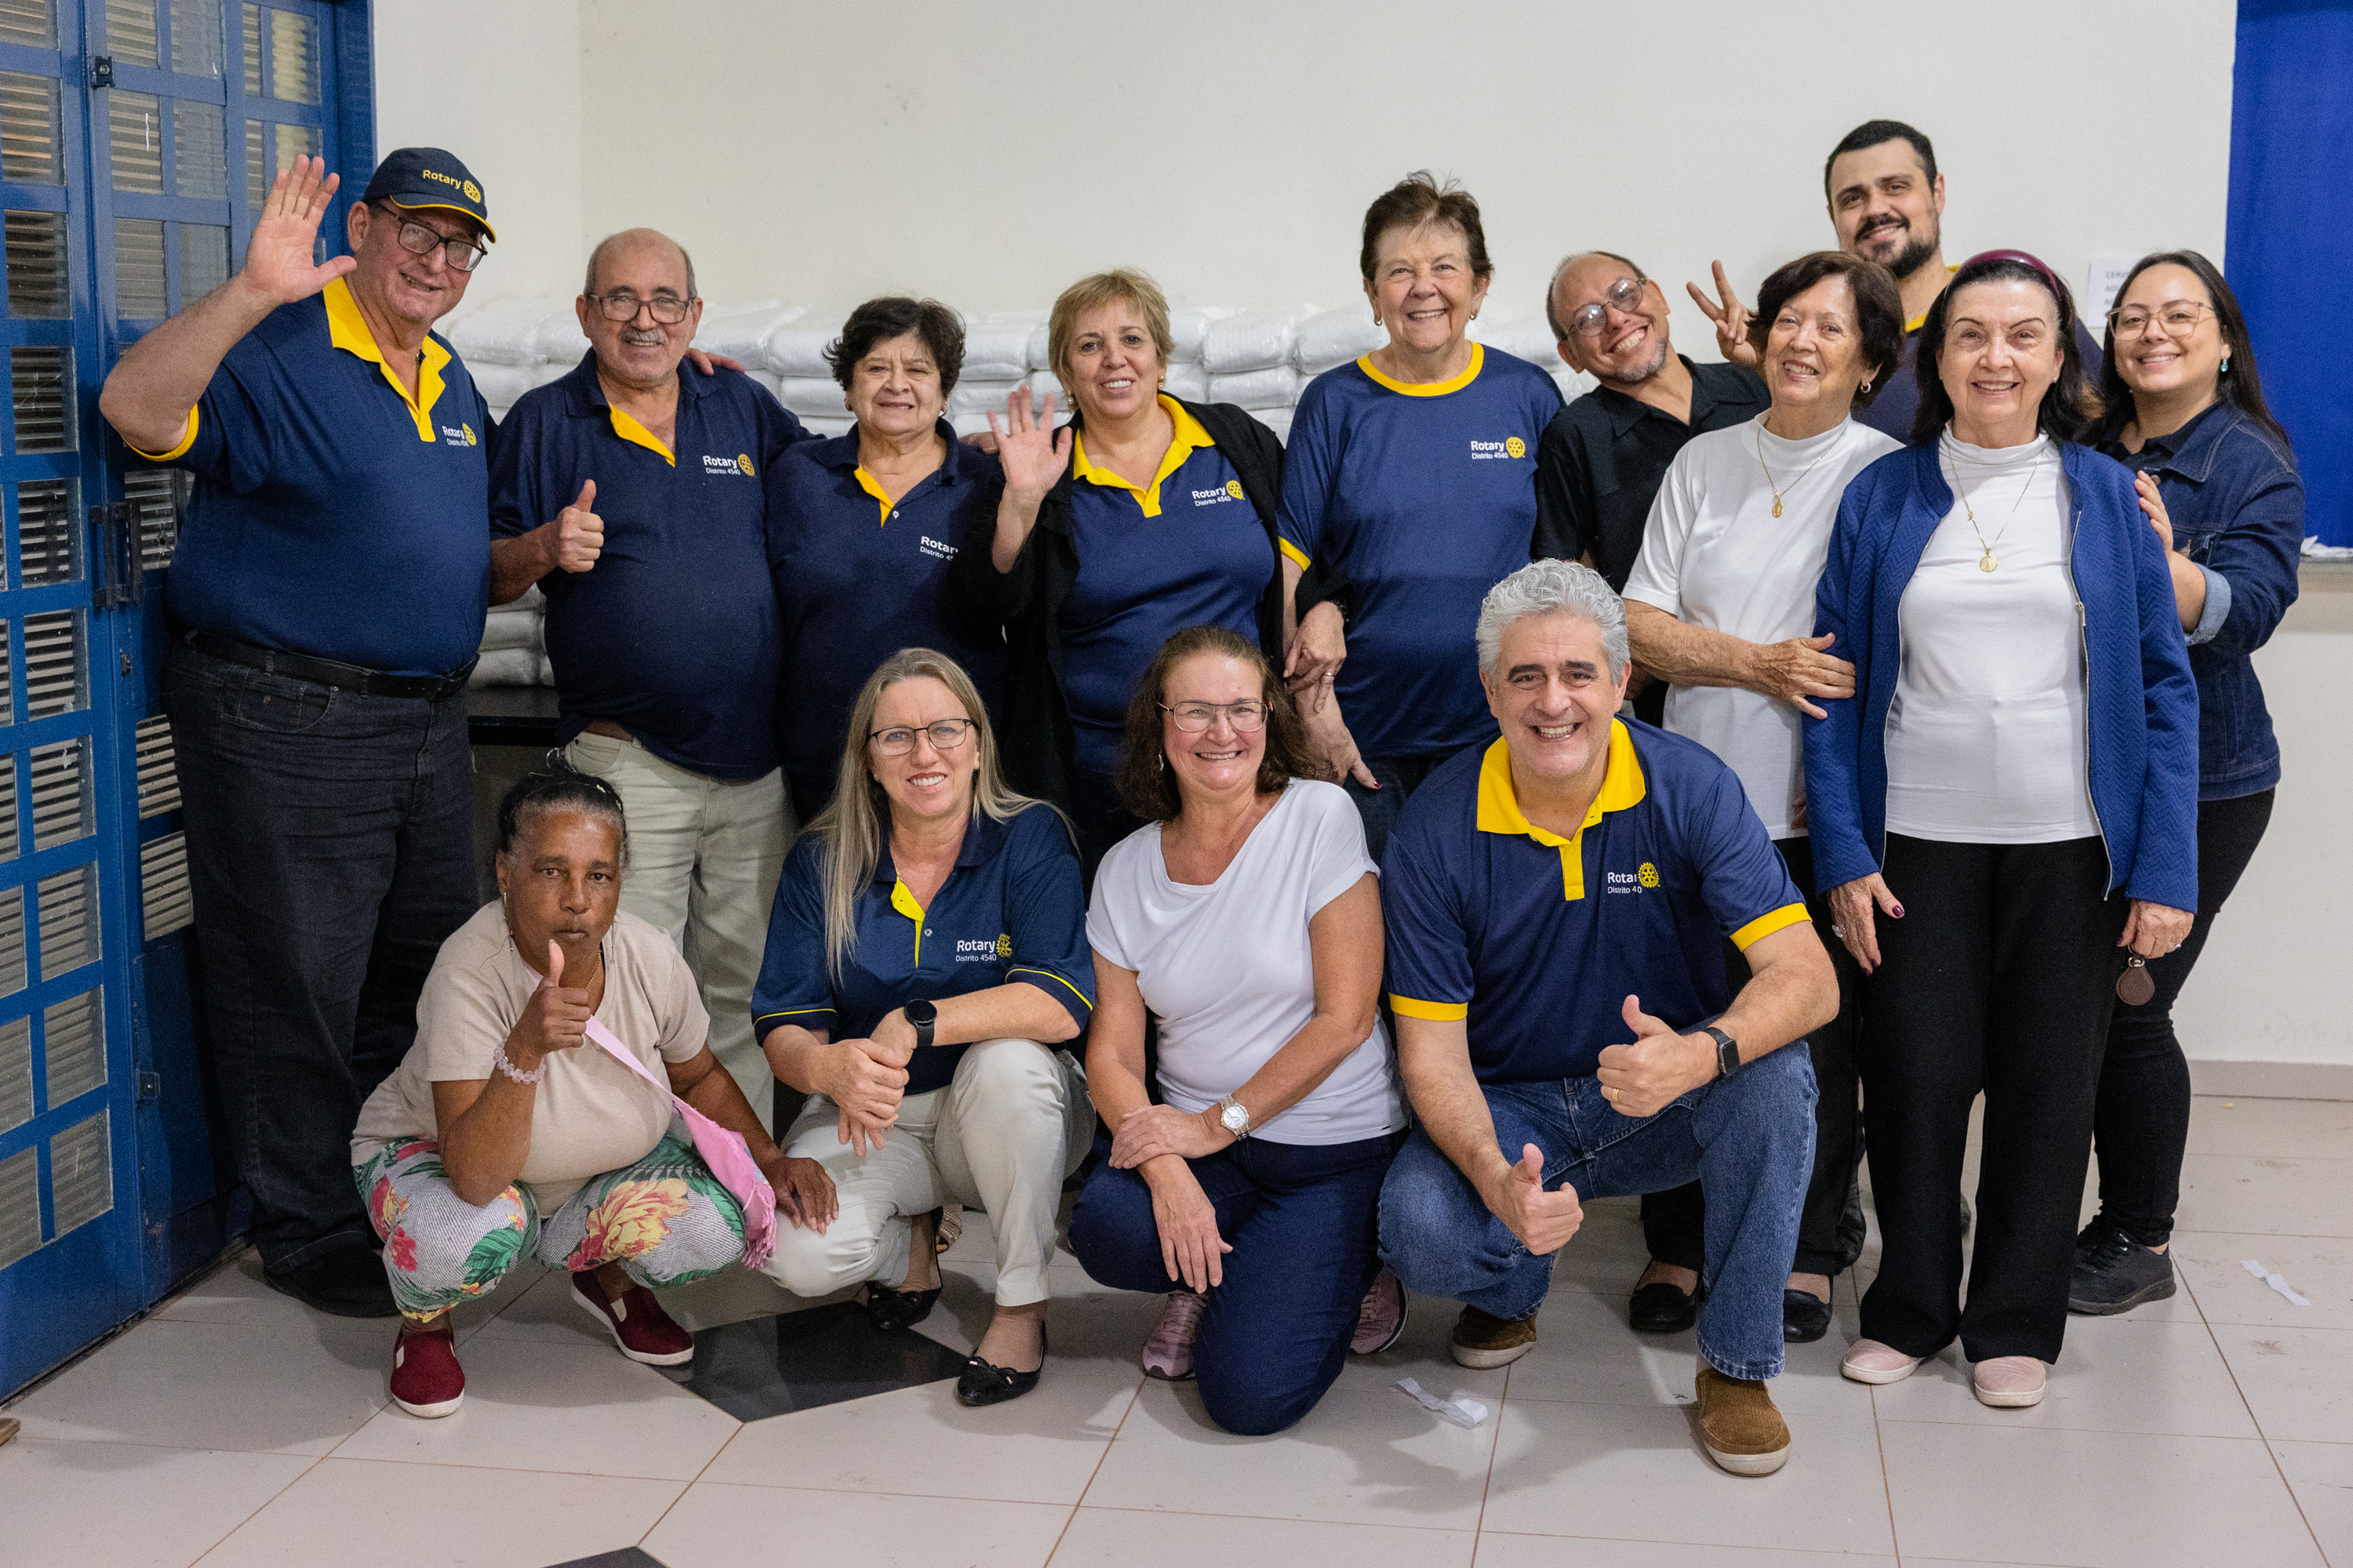

Individual and club recognition

Slide 11
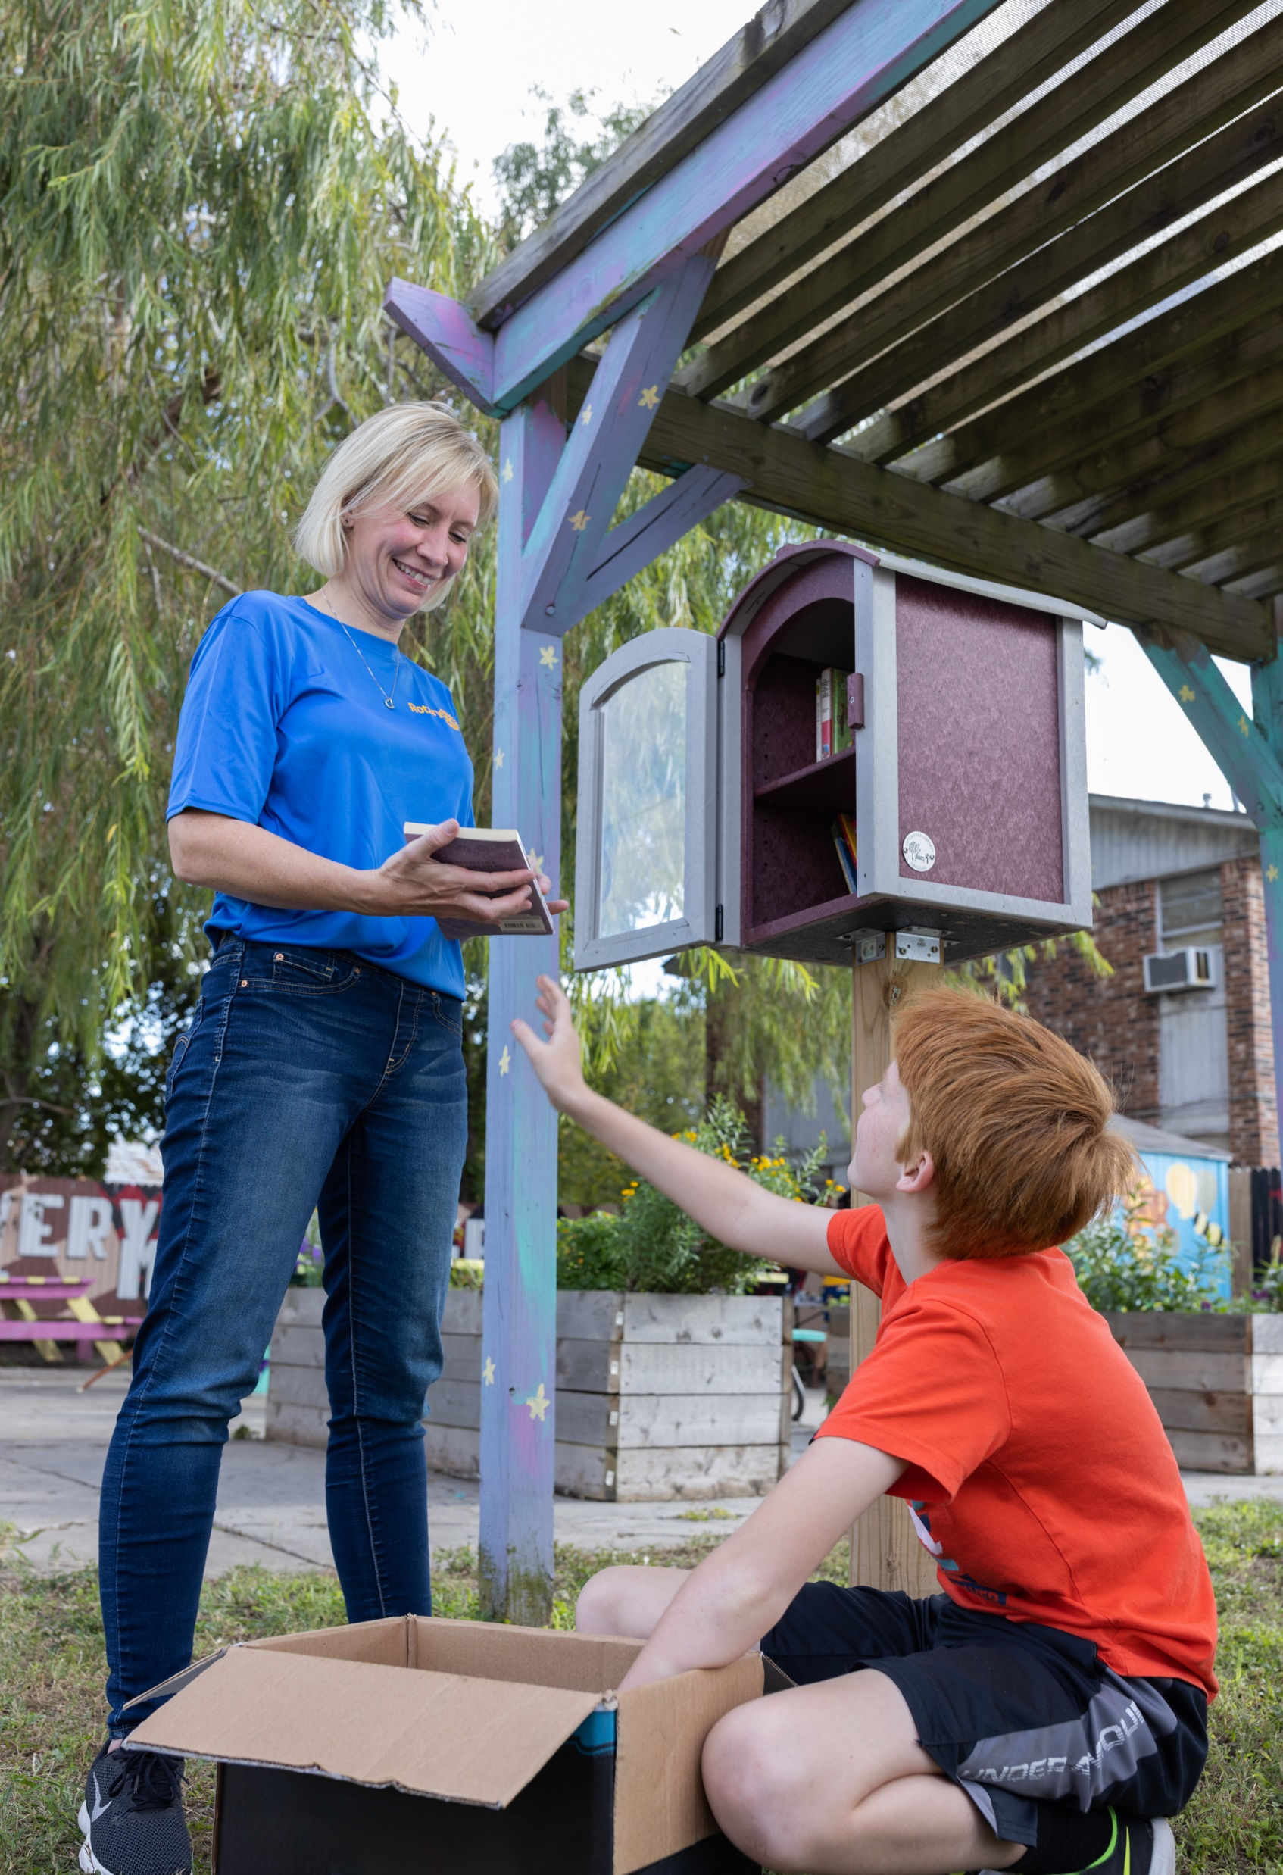





Sustaining our work
Sustaining members
A Rotary Foundation Sustaining Member is someone who gives US$100 or more to the Annual Fund.
Notes:
Without sustained support from the Annual Fund, Foundation programs cannot continue. But with contributions of US$100 from every member, every year, we could nearly double the resources available to help people in need.
Someone who contributes US$100 or more to the Annual Fund is a Rotary Foundation Sustaining Member. Use the Club Foundation Banner Report to identify these members and use Rotary Foundation Sustaining Member stickers to recognize them.
When you donate to Rotary, you can be certain that your gift will be used to its fullest potential by members around the world.

Slide 12

Paul harris Fellows
Paul harris Fellow recognition
Donors become Paul Harris Fellows when they earn 1,000 recognition points.
This can occur:
By contributing US$1,000 to eligible funds or approved grants
By being given 1,000 recognition points by another donor
By combining direct donations with points transferred by others
Notes:
We also recognize generous donors who give US$1,000 or more to the Annual Fund, the PolioPlus Fund, or an approved Foundation grant as Paul Harris Fellows. It’s the Foundation’s best-known recognition for individual donors.
[Thank any Paul Harris Fellows in the audience.]
The US$1,000 can be donated at once or in several smaller donations over time. Donors receive one Foundation recognition point for every U.S. dollar they contribute. (Endowment Fund contributions aren’t eligible.) Donors can also use their points to name someone else as a Paul Harris Fellow.
All Paul Harris Fellows receive a pin and certificate. For each additional US$1,000 donation, they receive recognition as a multiple Paul Harris Fellow, including a pin with gemstones determined by the amount they donated.
[Speaker may choose not to read all the information below of every multiple Paul Harris Fellow level with corresponding amount and pin details.]
Multiple Paul Harris Fellow recognition:
US$2,000: 1 sapphire
US$3,000: 2 sapphires
US$4,000: 3 sapphires
US$5,000: 4 sapphires
US$6,000: 5 sapphires
US$7,000: 1 ruby
US$8,000: 2 rubies
US$9,000: 3 rubies

Slide 13

PAUL HARRIS SOCIETY
LEADERS IN PHILANTHROPY
The Paul Harris Society recognizes people who express their intent to contribute US$1,000 or more each year to the Annual Fund, the PolioPlus Fund, the Disaster Response Fund, Disasters of Magnitude, or approved global grants.
The Paul Harris Society includes more than 35,000 philanthropic leaders around the world.
PHS members contributed 21.2% of all the money donated to the Annual Fund in 2024-25.
Notes:
The Paul Harris Society recognizes those generous donors who express their intent to give US$1,000 each year to the Annual Fund, the PolioPlus Fund, or approved global grants.
Paul Harris Society membership has grown from about 10,600 people in 2013-14 to more than 35,000 in 2024-25. During the same period, it has spread from 84 countries to more than 150 countries.
In 2024-25, society members accounted for nearly 21.2% of the money given to the Annual Fund, more than US$31 million.
Society members’ consistent support is incredibly important to a district. It means that each year, the district can rely on gifts from these donors to fund meaningful district grant and global grant projects.
Learn more at rotary.org/phs.
Donors who intend to contribute US$1,000 or more annually can join the society: https://rotary.qualtrics.com/jfe/form/SV_eCYMZ3u8qeCZALb
People can also subscribe to our quarterly PHS Resource email: https://rotary.msgfocus.com/k/Highroad-Solution/paul_harris_society_resource_sign_up

Slide 14
Major Donor & Arch KlumpH
LEADERS IN PHILANTHROPY
Major Donors are people who have cumulatively contributed US$10,000 or more to the Annual Fund, the PolioPlus Fund, the Disaster Response Fund, Disasters of Magnitude, or approved global grants. Major Donor 2 is $25,000 or more and so on.
Arch Klumph Society members are people who have cumulatively contributed $250,000 or more to Our Rotary Foundation.

Slide 15


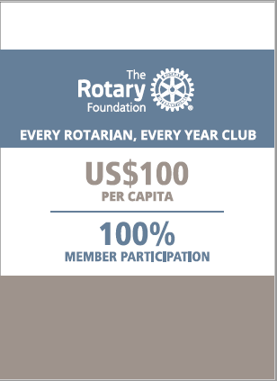
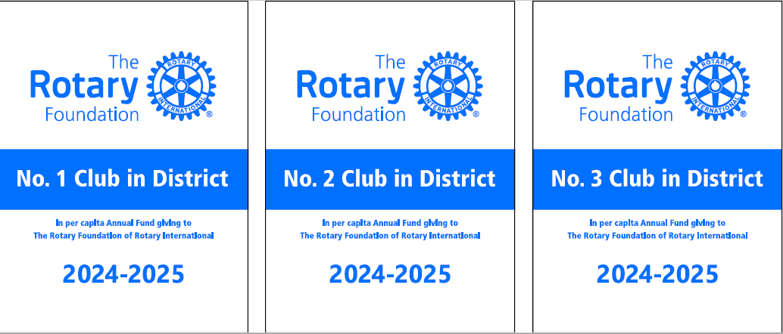
Club Recognition
Several club Foundation banners recognize outstanding giving, including:
170
$11.9
Every Rotarian, Every Year Club
100% Foundation Giving Club
100% Paul Harris Fellow Club
100% Paul Harris Society Club
101
$8.9
189
Notes:
We award Foundation banners to clubs that achieve outstanding giving:
The Every Rotarian, Every Year Club banner recognizes clubs whose members give an average of US$100 to the Annual Fund, with every member contributing at least US$25.
The 100% Foundation Giving Club banner recognizes clubs whose members give an average of US$100 to any Foundation fund, with every member contributing at least US$25.
The 100% Paul Harris Fellow Club banner recognizes clubs whose active members are all Paul Harris Fellows at the time when the district governor requests the banner. This banner can be earned only once.
The 100% Paul Harris Society Club banner recognizes clubs whose members each contribute at least US$1,000 to the Annual Fund, the PolioPlus Fund, Disaster Response Fund, Disasters of Magnitude or an approved global grant during a given Rotary year.
[Recognize any clubs that attained one or more of these achievements last year, and thank their members.]

Slide 16
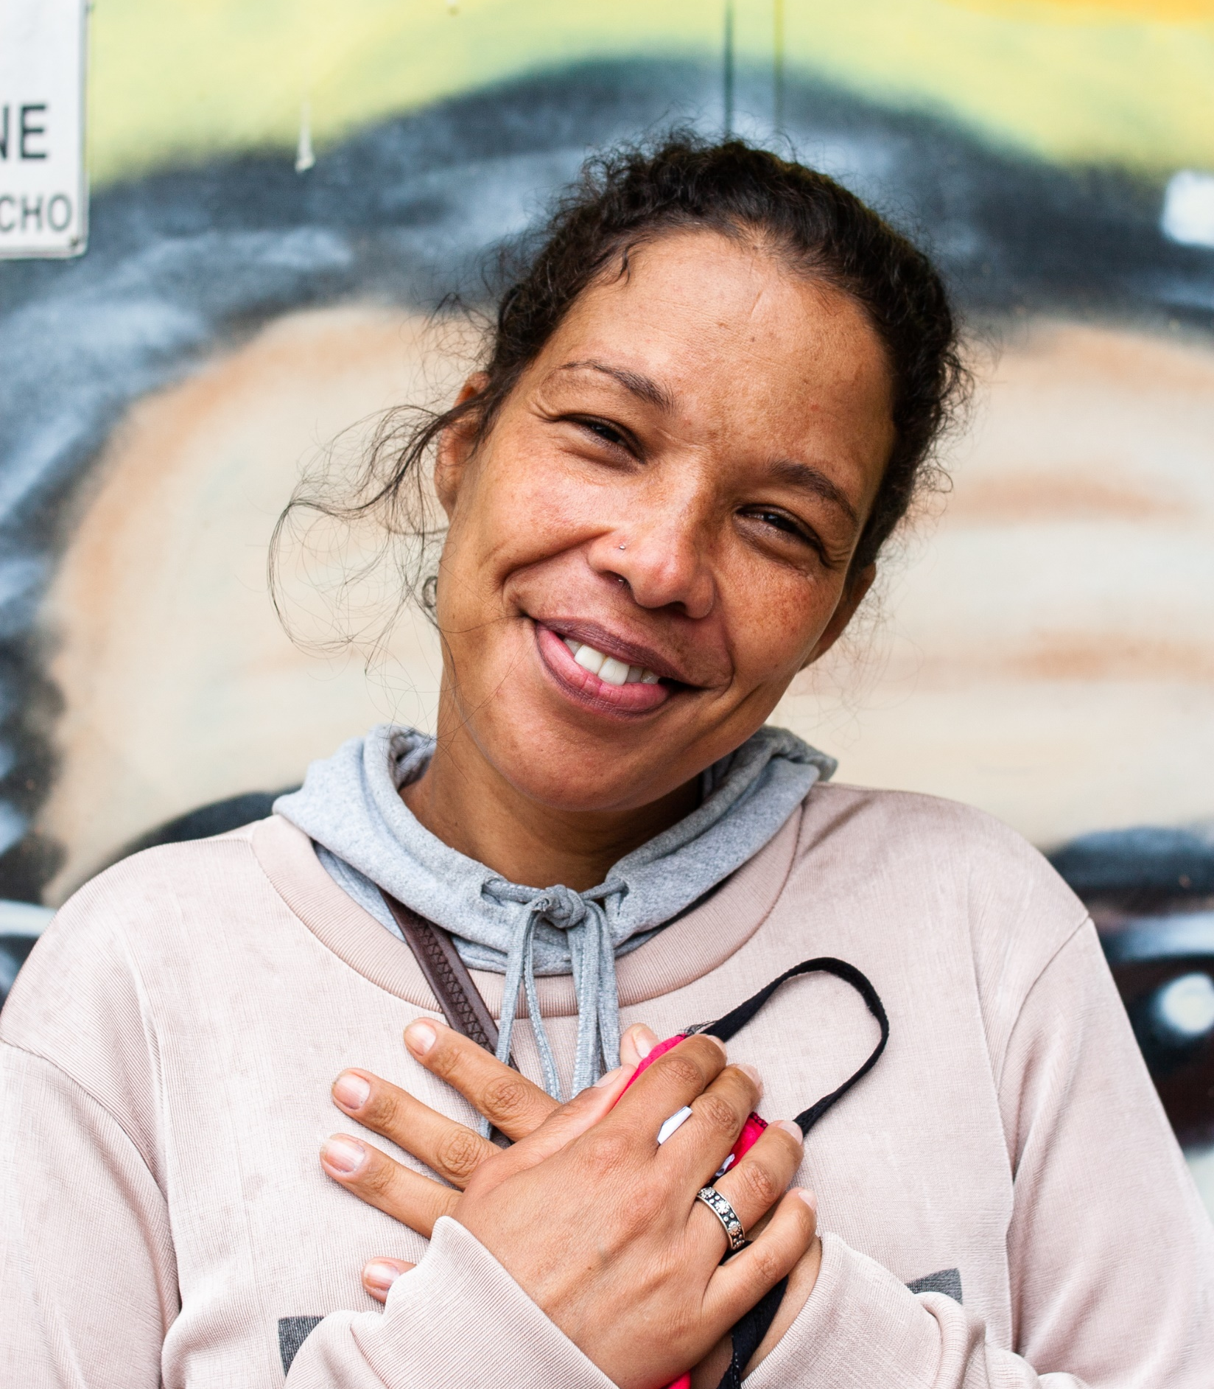
WAYS TO GIVE
Giving to the Annual Fund helps you achieve your Every Rotarian, Every Year recognition. You can:
Automate your giving through Rotary Direct
Donate online at rotary.org/donate
Give a check to your club Foundation chair
Mail your gift directly to the Foundation:
The Rotary Foundation 14280 Collections Center Drive Chicago, IL 60693 USA
You can also:
Use a gift to honor or remember someone
Increase your impact with corporate matching
Notes:
You can make our Foundation your charity of choice in many ways.
You can automate your donations through Rotary Direct, our recurring giving program.
You can give online at rotary.org/donate. If you sign in to My Rotary, your donation will automatically be connected to your account and credited to your club.
You can donate through your club by talking to your Foundation chair.
Or you can mail your gift by using the Foundation contribution form, available on My Rotary.
A donation made to remember a loved one is a meaningful memorial, and a donation in someone’s honor can be a perfect birthday, wedding, or holiday gift. You can designate a gift to honor or remember someone when you donate through My Rotary.
If your company matches charitable donations, consider having it match yours. Explore the matching gift FAQ (linked on the slide) or write to our Annual Giving staff at annualfund@rotary.org for details.
Note that some giving methods are not available in every country.

Slide 17
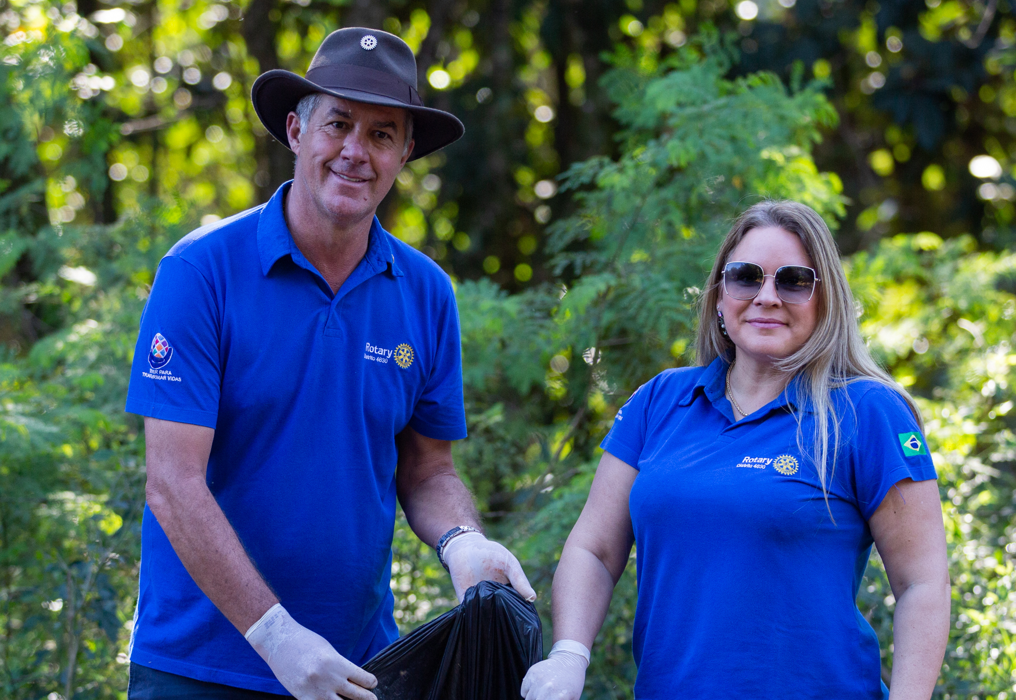

Rotary Direct
Signing up for a recurring donation in support of our Annual Fund makes it easy to achieve your Every Rotarian, Every Year recognition:
Scan to enroll today
It’s easy, fast, and secure.
You can give monthly, quarterly, or annually.
You can adjust your donations or cancel anytime through My Rotary or by calling +1-866-976-8279.
Visit my.rotary.org/rotary-direct to learn more or enroll.
Notes:
Using Rotary Direct, the Foundation’s recurring giving program, is easy, fast, and secure. You can personalize your donation schedule to accomplish your philanthropic goals and empower Rotary members around the world to change lives. Get started by visiting my.rotary.org/rotary-direct.

Slide 18
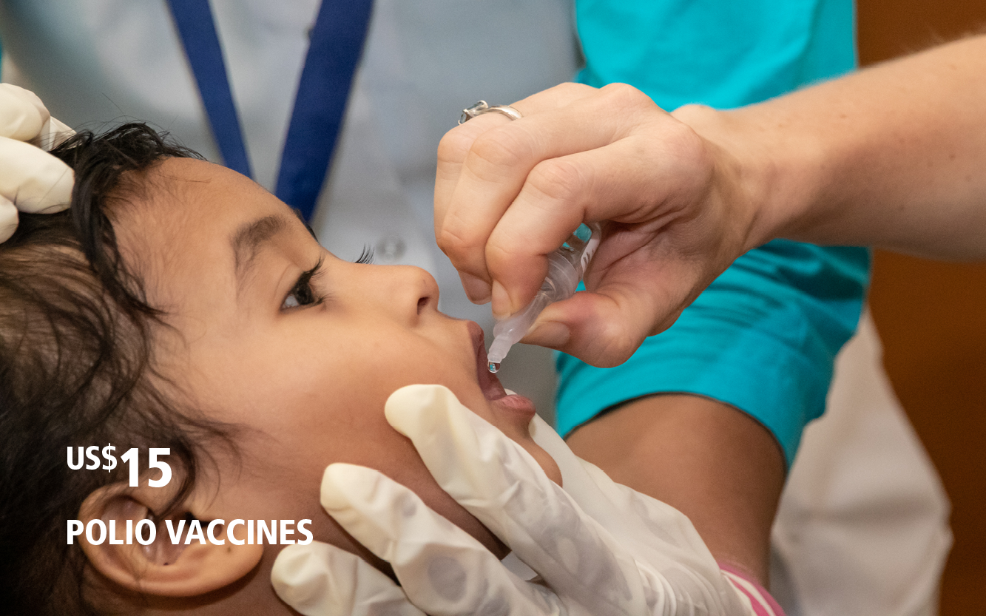
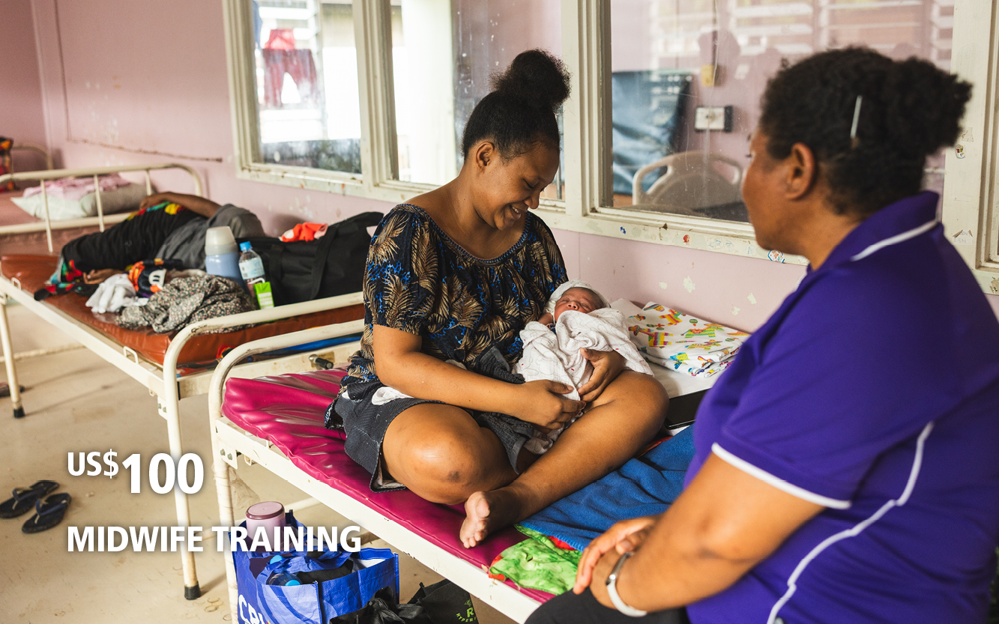
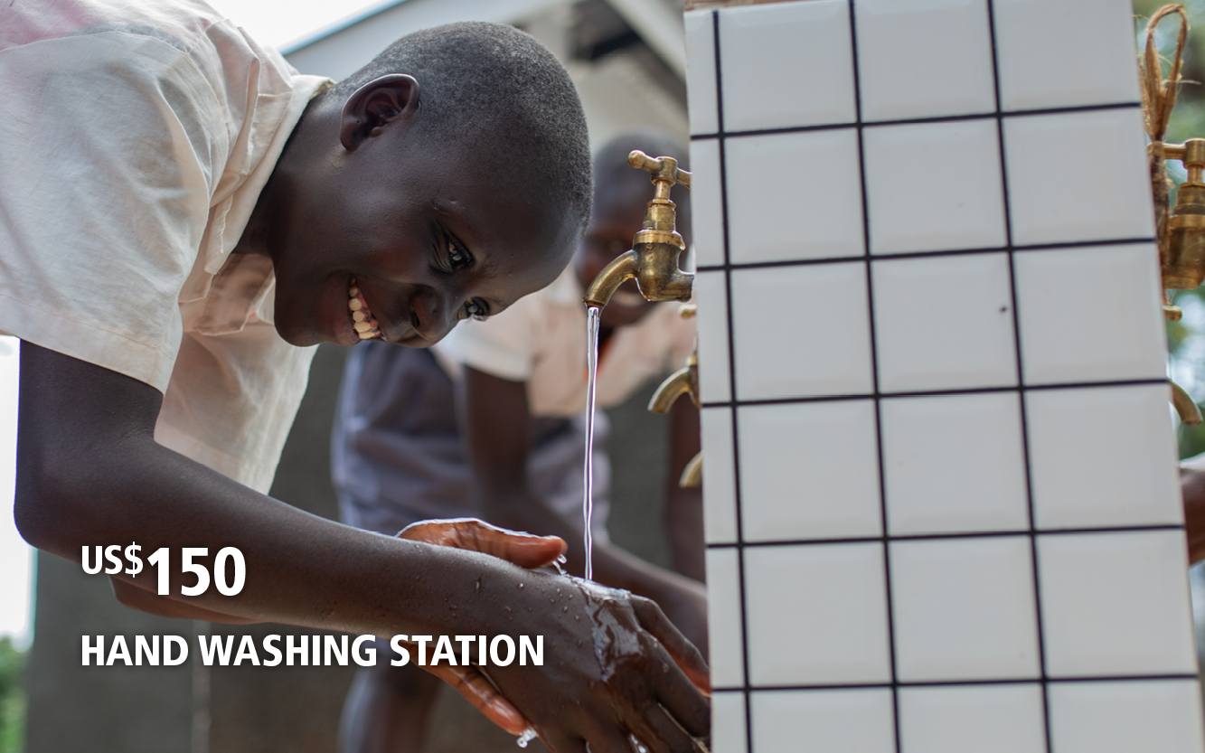
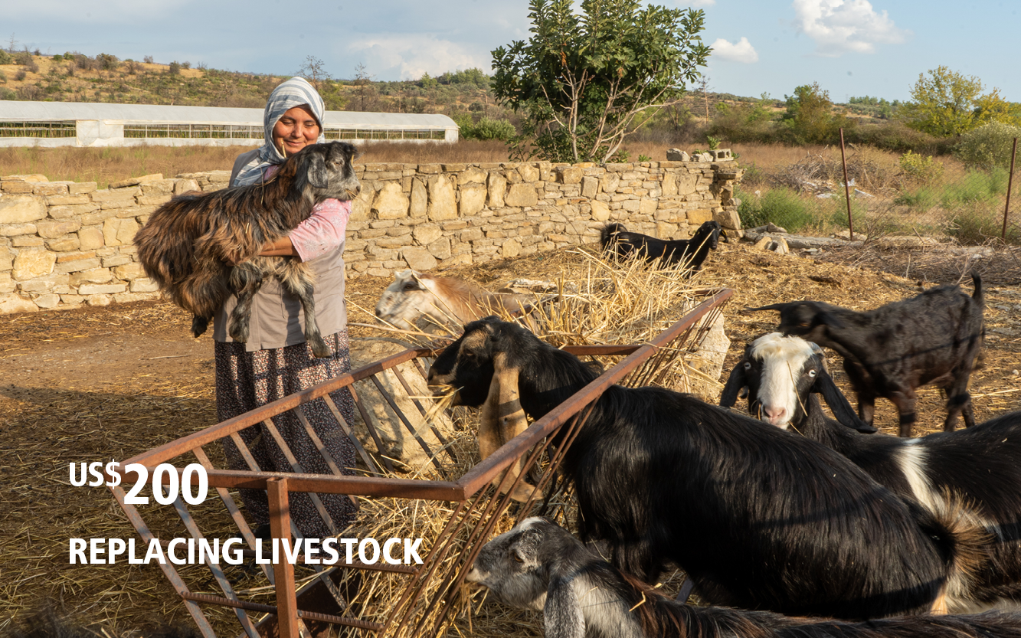
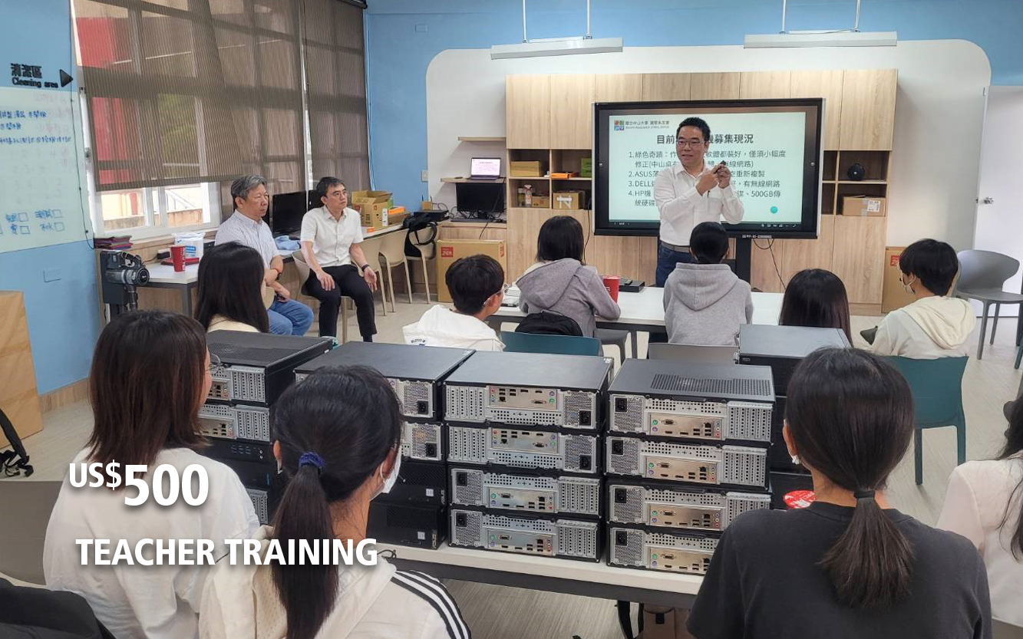
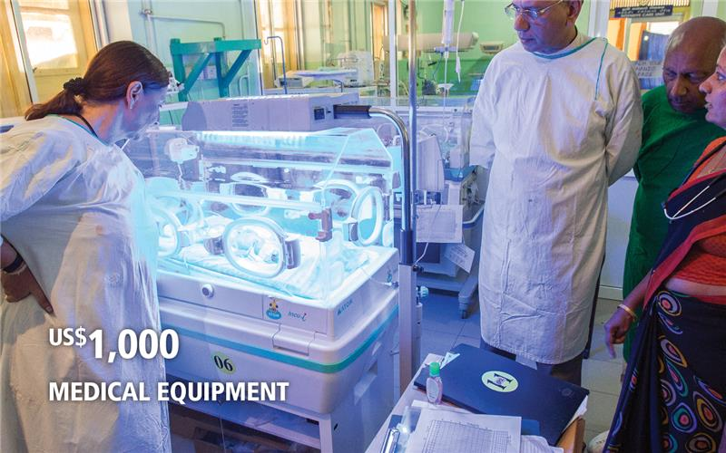
YOUR GIFT AT WORK
Gifts of any size can make a big impact.
In 2024-25, The Rotary Foundation was able to fund 1,424 global grants because of our generous donors.
No matter how you choose to give, your gift will help Rotary members keep Doing Good in the World.
Donations fund both local and international projects.
Donors are eligible to earn recognition and donor credit.
Notes:
No matter how you choose to give, I hope you’ll join me in supporting our Foundation by donating to the Annual Fund this year. Remember, gifts of any size have a big impact when they’re put to use by our Foundation and our network of members around the world.

Slide 19
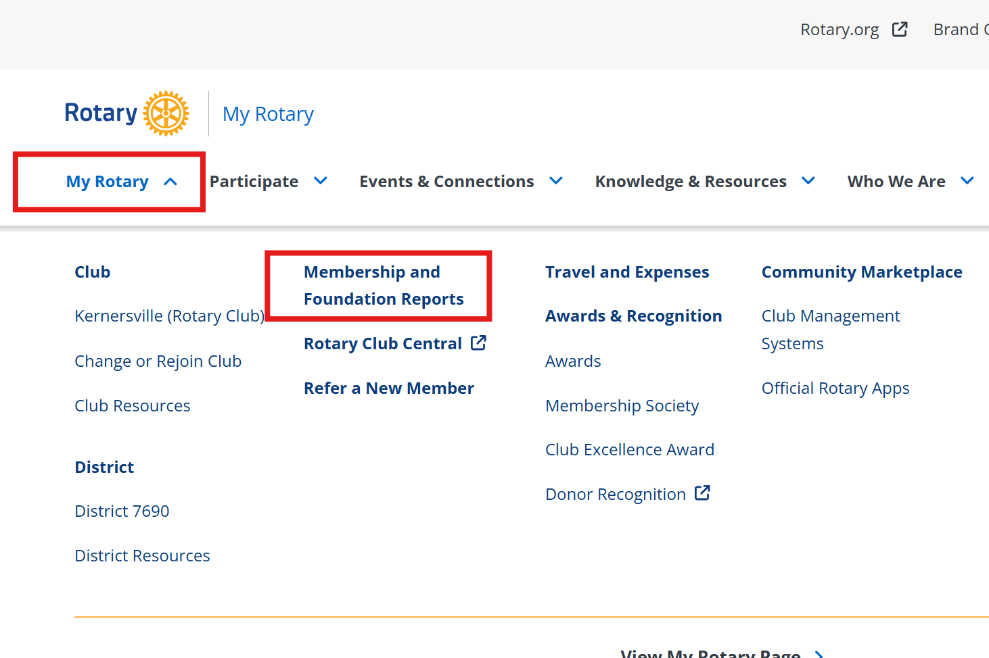
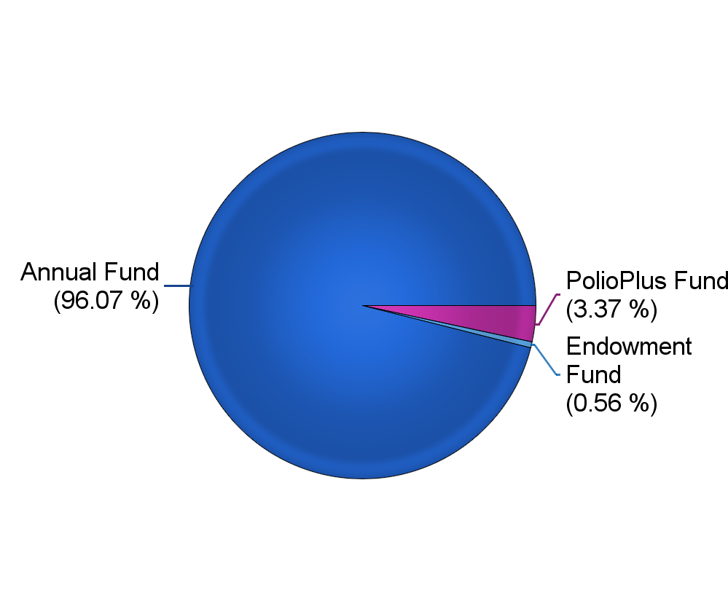
My Rotary Reports

Slide 20
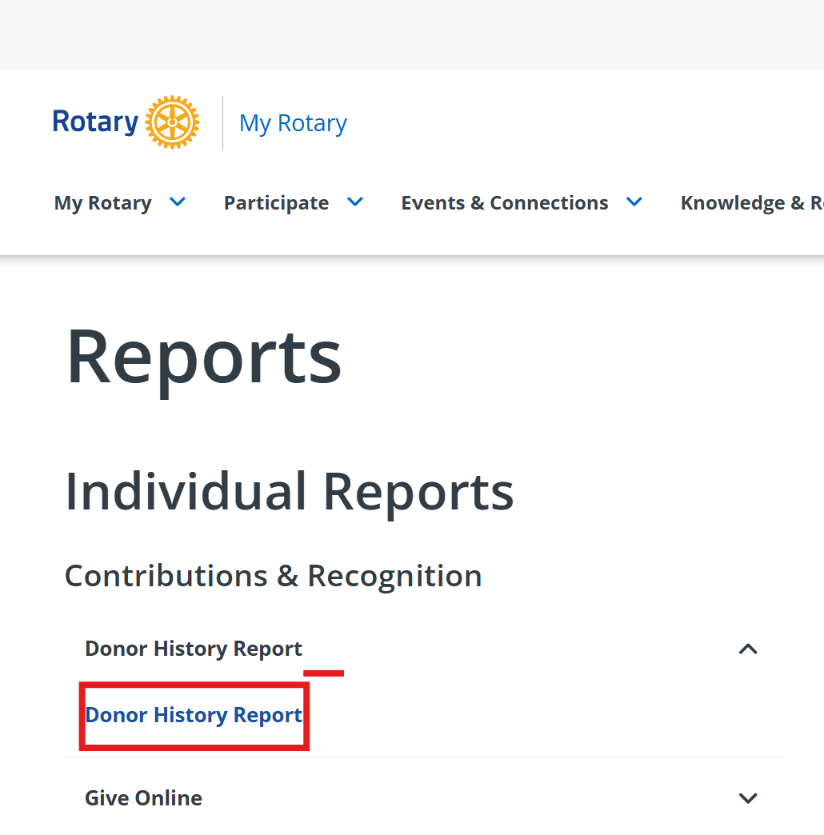
Donor History Report

Slide 21
Donor history Report
Recognition -
Type
Major Donor or AKS*: |  | Major Donor Level 1
Bequest or Legacy Society*: |  | - |  |  |  |  |  | Paul Harris Fellow: | PHF+8
Benefactor: |  | Yes |  |  |  |  |  | PHF Recognition Amount: | 17,977.70
 |  | Current Year |  | Last Year |  |  |  | Foundation Recognition Points: | 15,252.70
Paul Harris Society Eligible |  | Jan-2026 |  | Feb-2025 |  |  |  | (Available for transfer)
Sustaining Member |  | Jul-2025 |  | Jul-2024 |  |  |  | Paul Harris Society Member: | Yes
Every Rotarian Every Year (US$25) |  | Jul-2025 |  | Jul-2024
Gifts* |  |  | Rotary Direct Participant
Type |  |  |  |  |  | Total
Annual Fund
Disaster Response |  |  | $890.00 |  |  | $17,127.70
SHARE |  |  | $16,237.70
PolioPlus Fund
PolioPlus |  |  | $600.00 |  |  | $600.00
Endowment Fund
Rotary Peace Centers General Support |  |  | $100.00 |  |  | $100.00
Sub Total |  |  |  |  |  | $17,827.70
Total Giving |  |  |  |  |  | $17,827.70
Bequest/Legacy Society and Benefactor Commitments*
Type |  |  |  |  | Total
World Fund: Will |  |  |  |  | $1,000.00
Sub Total |  |  |  |  | $1,000.00
Total Commitments |  |  |  |  | $1,000.00

Slide 22
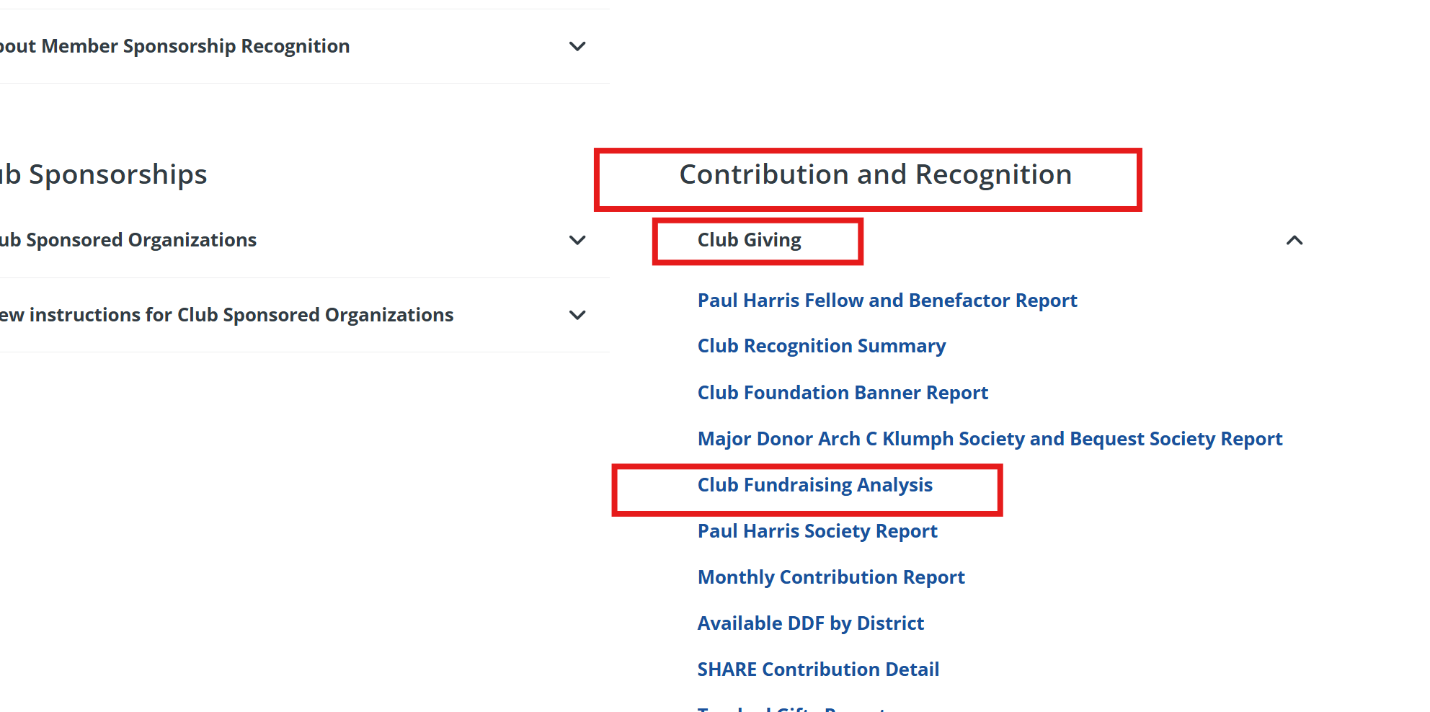
Club FUNdraising analysis

Slide 23
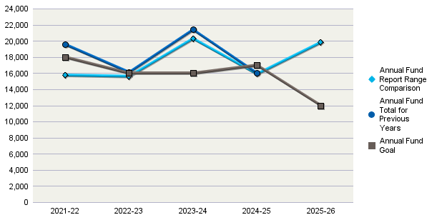
Club FUNdraising analysis
District 7690
Annual Fund Goal |  |  | Annual Fund Contributions |  |  |  |  | Total Contributions*
2025-26 | $12,000 |  | 2025-26 | $19,851 |  |  |  | 2025-26 |  | $29,648
2024-25 | $17,000 |  | 2024-25 | $16,008 |  |  |  | 2024-25 |  | $39,026
2023-24 | $16,000 |  | 2023-24 | $21,400 |  |  |  | 2023-24 |  | $32,600
2022-23 | $16,000 |  | 2022-23 | $16,116 |  |  |  | 2022-23 |  | $26,467
2021-22 | $18,000 |  | 2021-22 | $19,575 |  |  |  | 2021-22 |  | $33,275
 |  |  |  |  |  |  |  | AF Per Capita |  | Club | District
 |  |  |  |  |  |  |  | 2025-26 |  | $231 | $166
 |  |  |  |  |  |  |  | 2024-25 |  | $160 | $194
 |  |  |  |  |  |  |  | 2023-24 |  | $216 | $192
 |  |  |  |  |  |  |  | 2022-23 |  | $183 | $185
 |  |  |  |  |  |  |  | 2021-22 |  | $215 | $180
 |  |  |  |  |  |  |  | Membership
 |  |  |  |  |  |  |  | 2025-26 |  | 86
 |  |  |  |  |  |  |  | 2024-25 |  | 100
 |  |  |  |  |  |  |  | 2023-24 |  | 99
 |  |  |  |  |  |  |  | 2022-23 |  | 88
 |  |  |  |  |  |  |  | 2021-22 |  | 91
 |  |  |  |  |  |  |  |  | EREY Members | Sustaining Members | PHS Eligible
 |  |  |  |  |  |  | 2025-26 |  | 90 | 90 | 5
Annual Fund Report Range Comparison is the Annual Fund giving from 1 July to 31 May for current and previous years |  |  |  |  |  |  | 2024-25 |  | 97 | 96 | 4
 |  |  |  |  |  |  | 2023-24 |  | 92 | 92 | 6
The prior four-year average in Annual Fund giving from July through 31 May is $16,896. This figure can be used to compare Annual Fund giving for the current Rotary year. |  |  |  |  |  |  | 2022-23 |  | 95 | 94 | 4
*Total Contributions include Annual Fund, PolioPlus, approved Foundation Grants, Other Giving, and Endowment contributions for the reporting period. |  |  |  |  |  |  | 2021-22 |  | 102 | 101 | 6
 |  |  |  |  | Note: 'EREY Members' reflect the number of donors who contributed some amount to the Annual Fund during the Rotary Year. 'Sustaining Members' reflect the number of donors who contributed US$100 or more to the Annual Fund. 'PHS Eligible' reflect the number of donors who contributed US$1,000 or more to the Annual Fund, Polio Plus or approved Foundation Grant.
For questions and additional club reports please use MyRotary or call the Rotary Support Center toll free at (+1-866-976-8279) or by email at (rotarysupportcenter@rotary.org).

Slide 24
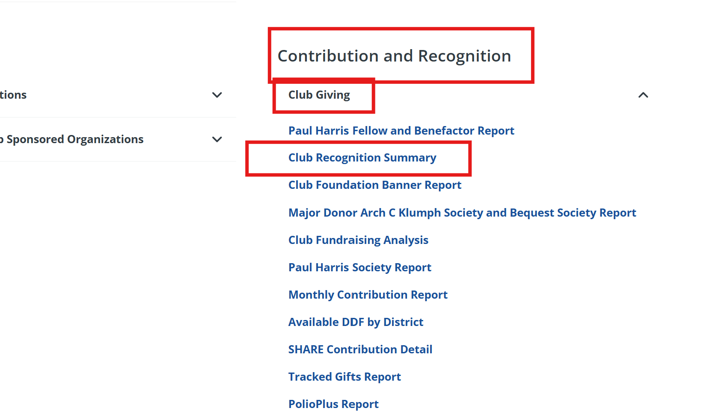
Club recognition summary

Slide 25
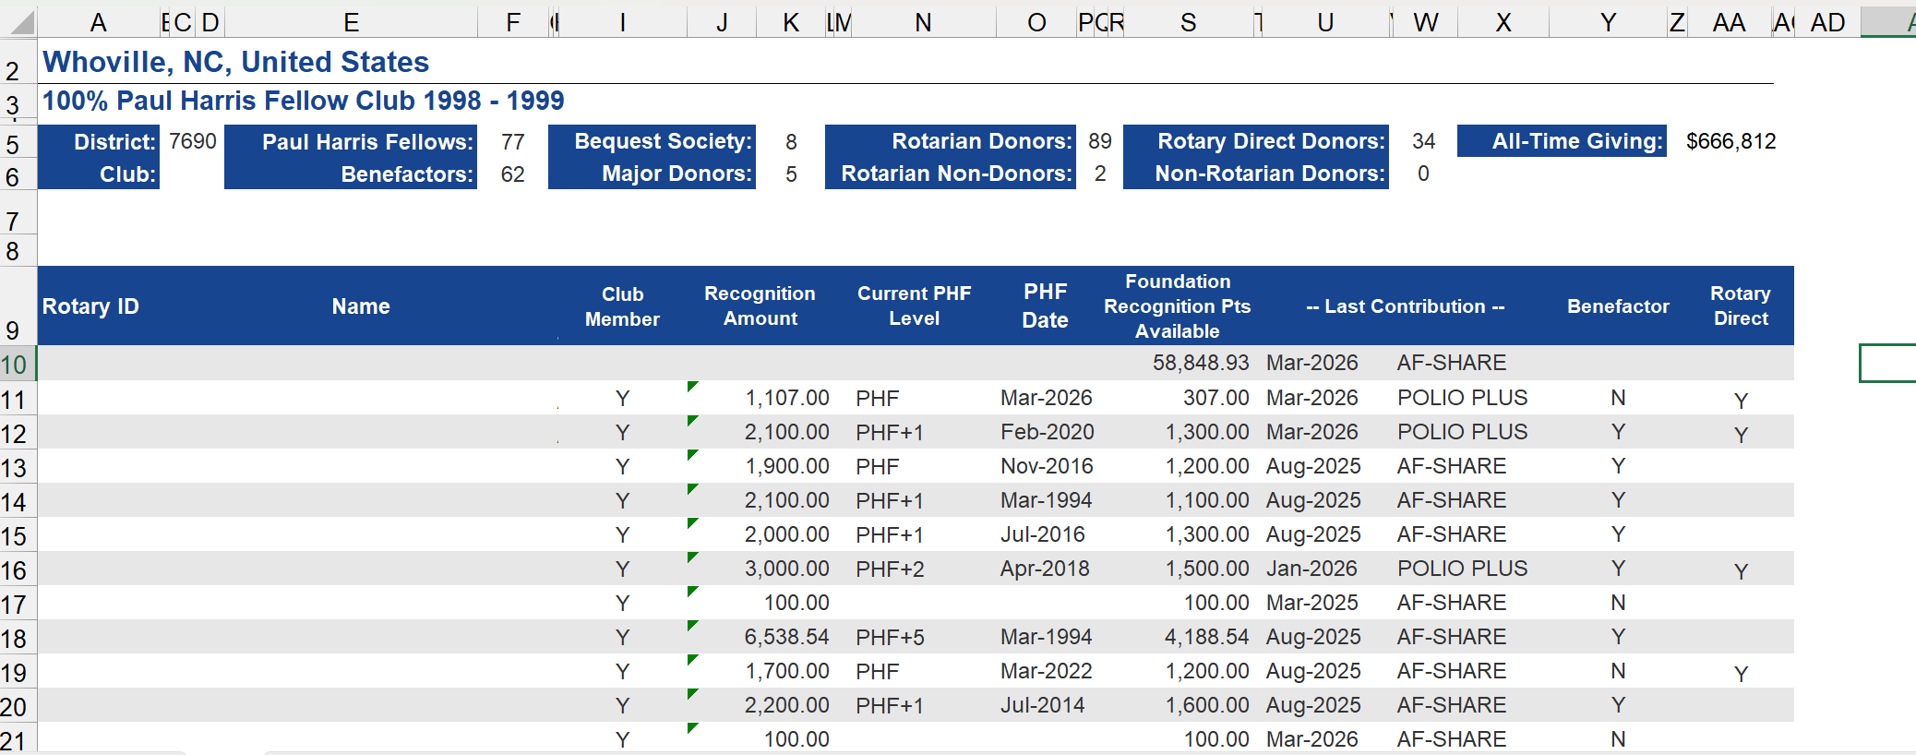
Club recognition summary

Slide 26
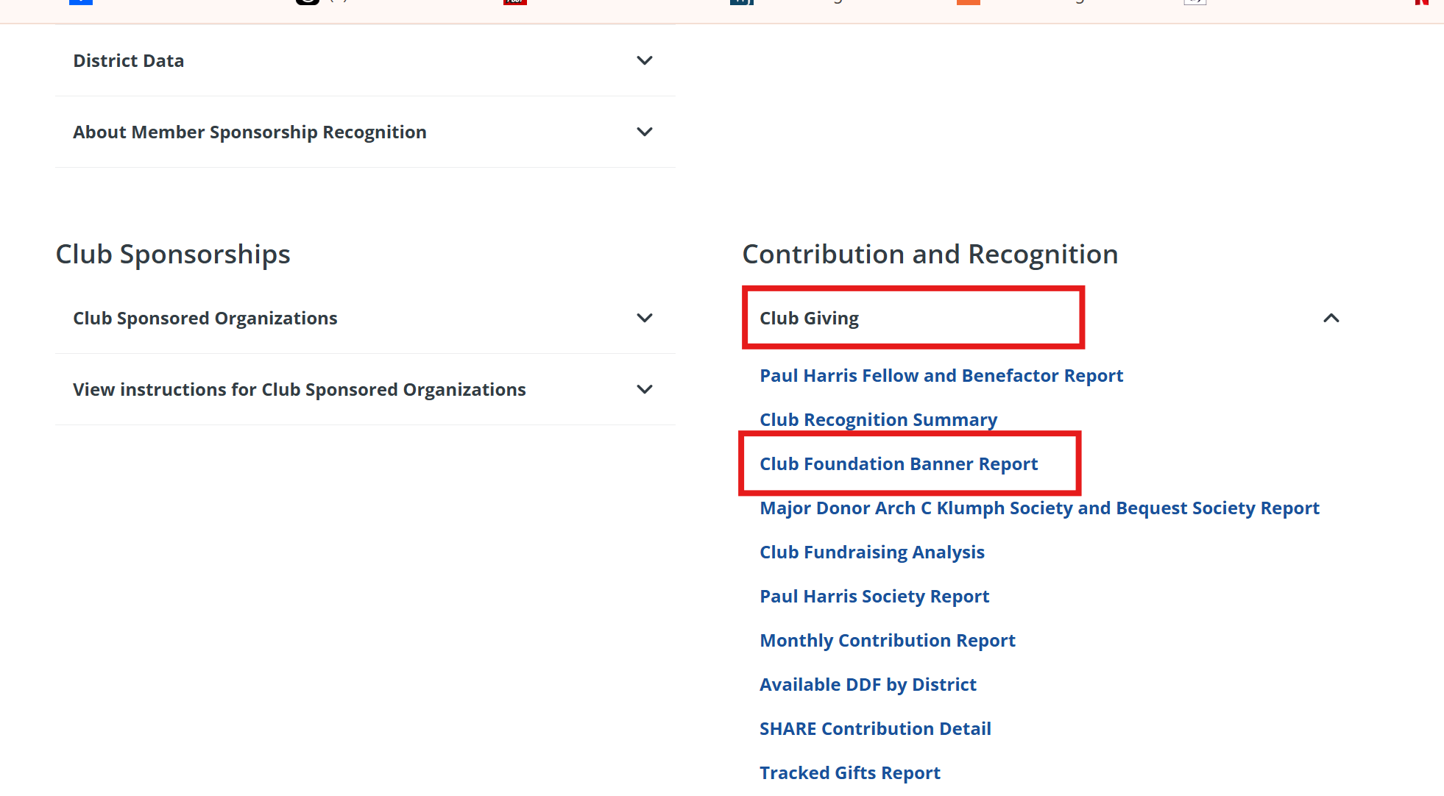
Club foundation banner report

Slide 27
Club foundation banner report
Rotary Club of [ ________], District 7690 |  |  |  |  |  |  |  |  |  |  |  |  |  |  |  |  | 1 July Members |  | 86
All Active Rotarians |  | 91 |  | TRF Giving Rotarians: | 81 |  | EREY Rotarians: | 81 |  | Sustaining Member Rotarians: |  | 81 |  | PHS Eligible Rotarians: | 5 |  | Annual Fund Per Capita: |  | $237.97
Existing Active Rotarians |  | 82 |  | Percent TRF Giving: | 98.8% |  | Percent EREY: | 98.8% |  | Percent Sustaining Members: |  | 98.8% |  | Percent PHS Eligible: | 6.1% |  | Average TRF Giving: |  | $353.04
Existing Active Rotarians are those with an admission date prior to 1 July. Beginning in 2015-16, only existing members are counted for EREY, TRF Giving, RFSM, or PHS participation.
Rotary ID | Rotarian Name |  |  |  |  | Club Member on 09-May-2026 |  | TRF Giving Achieved |  |  | EREY Achieved |  | Sustaining Member Achieved |  | PHS Eligible Achieved |  |  | Paul Harris Society Member | Rotary Direct
 |  |  |  |  |  | Y |  | 2-Aug-2025 |  |  | 2-Aug-2025 |  | 2-Aug-2025 |  |  |  |  |  | Y
 |  |  |  |  |  | Y |  | 2-Aug-2025 |  |  | 2-Aug-2025 |  | 2-Aug-2025 |  |  |  |  |  | Y
 |  |  |  |  |  | Y |  | 2-Aug-2025 |  |  | 2-Aug-2025 |  | 2-Aug-2025
 |  |  |  |  |  | Y |  | 2-Aug-2025 |  |  | 2-Aug-2025 |  | 2-Aug-2025
 |  |  |  |  |  | Y |  | 2-Aug-2025 |  |  | 2-Aug-2025 |  | 2-Aug-2025
 |  |  |  |  |  | Y |  | 2-Aug-2025 |  |  | 2-Aug-2025 |  | 2-Aug-2025 |  |  |  |  |  | Y
 |  |  |  |  |  | Y
 |  |  |  |  |  | Y |  | 2-Aug-2025 |  |  | 2-Aug-2025 |  | 2-Aug-2025
 |  |  |  |  |  | Y |  | 2-Aug-2025 |  |  | 2-Aug-2025 |  | 2-Aug-2025 |  |  |  |  |  | Y
 |  |  |  |  |  | Y |  | 2-Aug-2025 |  |  | 2-Aug-2025 |  | 2-Aug-2025
 |  |  |  |  |  | New |  | 19-Mar-2026 |  |  | 19-Mar-2026 |  | 19-Mar-2026
 |  |  |  |  |  | Y |  | 2-Aug-2025 |  |  | 2-Aug-2025 |  | 2-Aug-2025 |  |  |  |  |  | Y
 |  |  |  |  |  | Y |  | 2-Aug-2025 |  |  | 2-Aug-2025 |  | 2-Aug-2025

Slide 28
Wrap up & Q&A
Jim Fradenburg, DRFC
336-403-3784
Jim.Fradenburg@wbd-us.com

